Slide 1
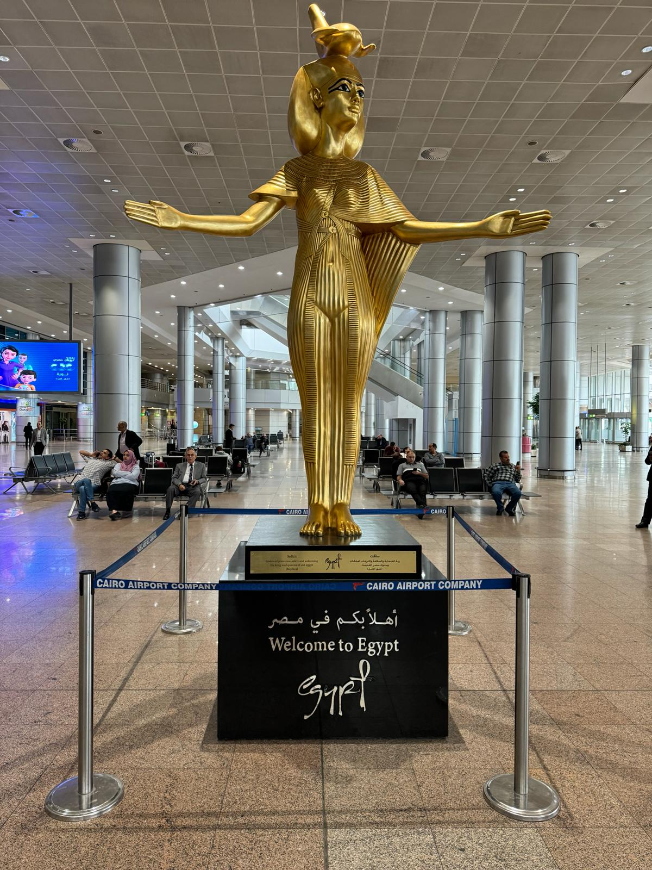
A Presentation by
Pastor Austen Ukachi
During Continental Conference in Egypt 9th & 10th April, 2024

Slide 2
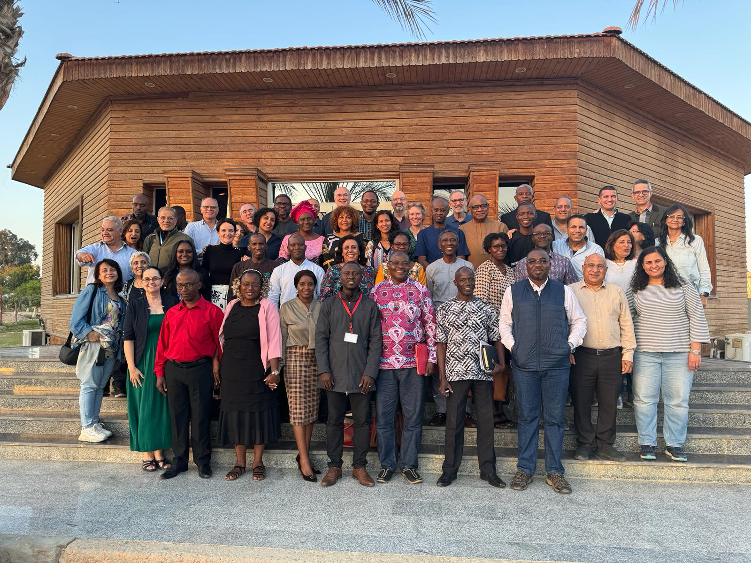
Next Steps Recommendations
During the Continental Conference in Egypt (9th & 10th April, 2024)

Slide 3
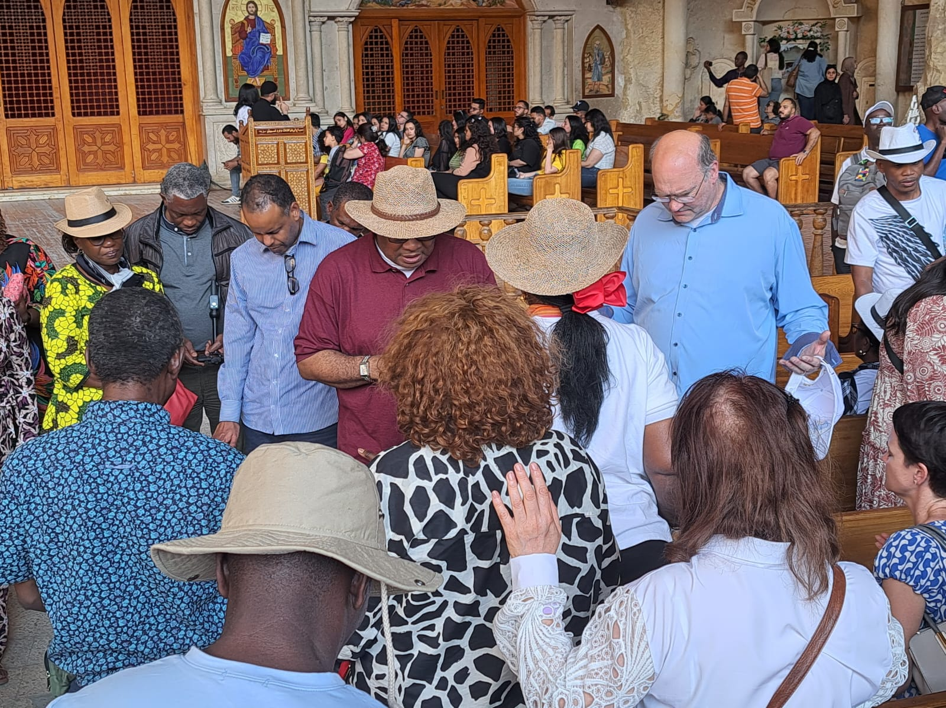
PRAY! PRAY!! PRAY!!!
FOR THE CONTINENTAL CHALLENGES FACING AFRICA
Our vision and mission can only be actualized as we persist in prayer. We must continue to pray for the continental challenges.

Slide 4
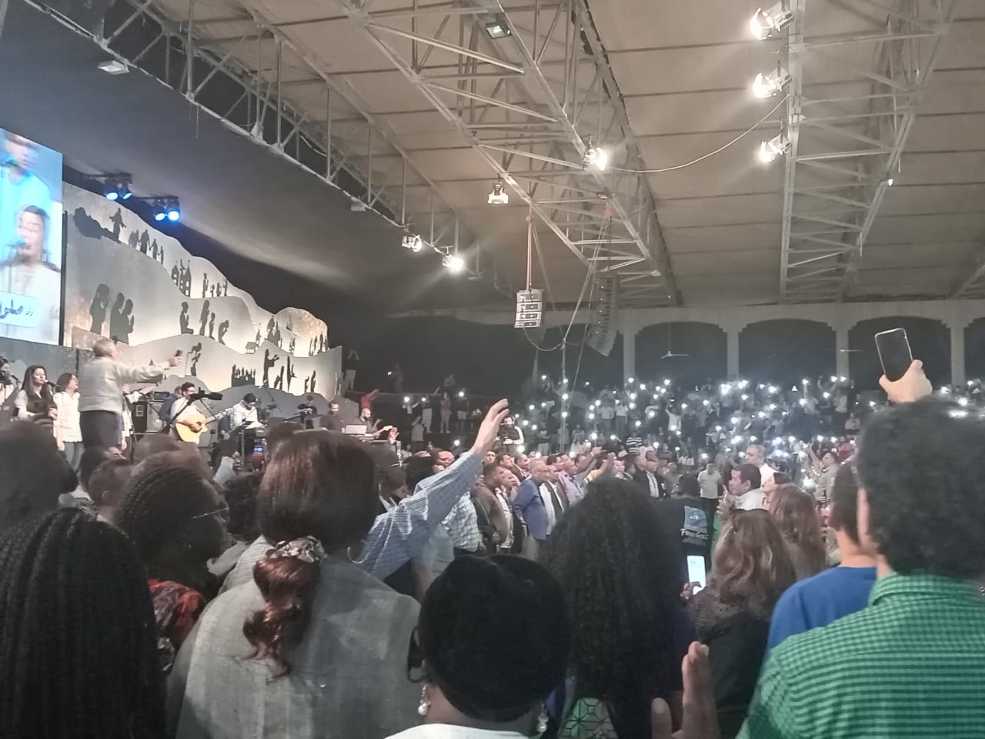
Let us continue to observe and pray for the four Global Days of Prayer, namely, the Global Day of Prayer for the Buddhist World, the Global Day of Prayer for the Muslim World, the Global Day of Prayer for the Muslim World, and the Global Day of Prayer for the Jewish World.

Slide 5
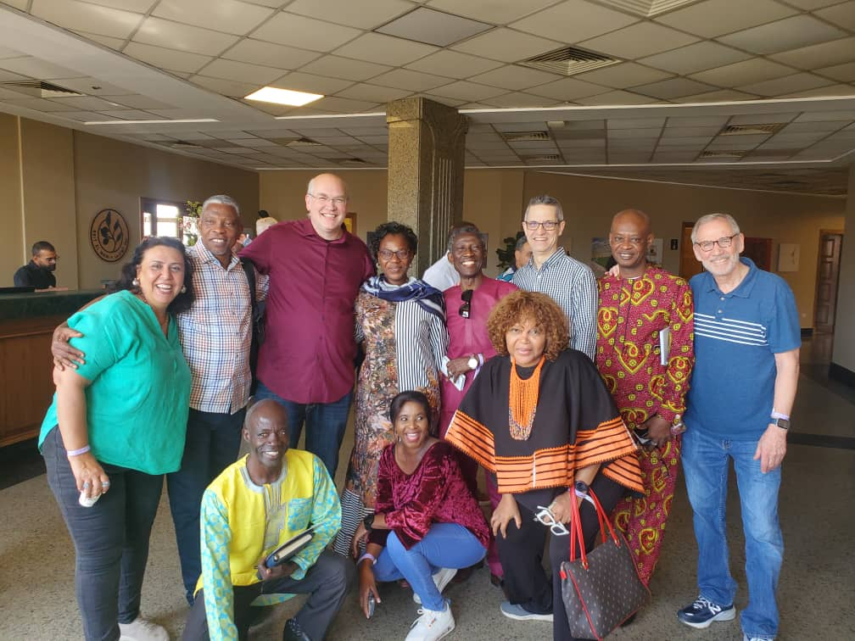
REGIONAL MEETINGS AND THE REGIONAL TEAM REPORTS
Monthly Regional prayer meetings to continue on stipulated days of the month.
Monthly attendance is encouraged and reports to be compiled and forwarded to the Continental Secretary and Coordinator.

Slide 6
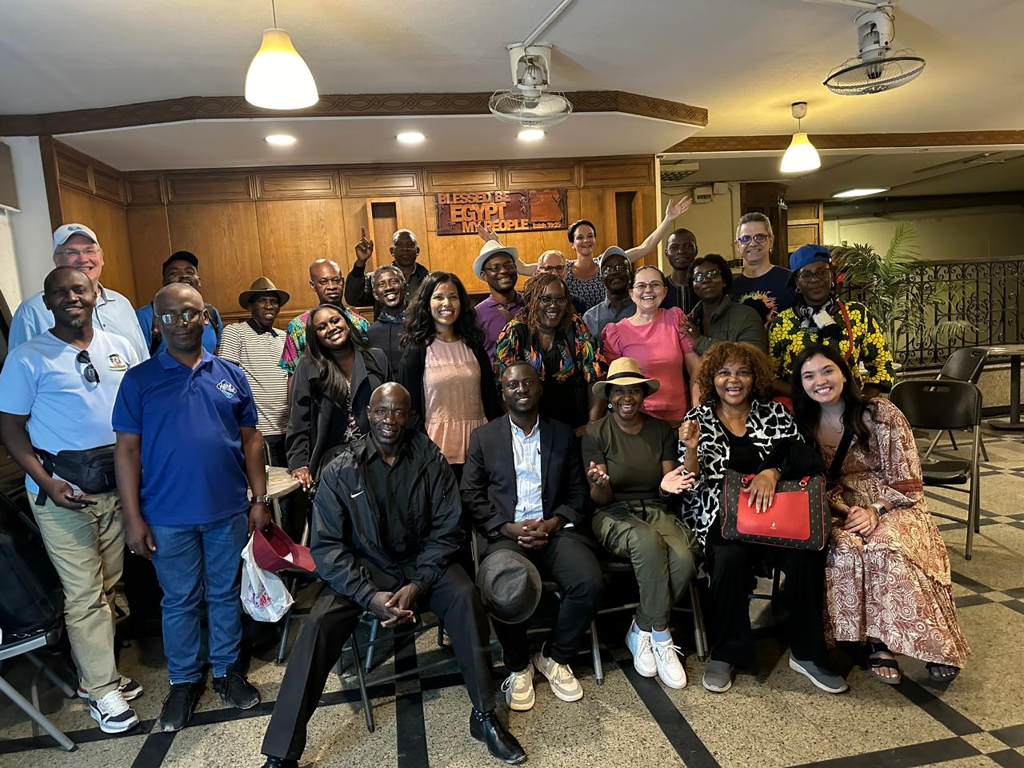
We Need Regional Councils in Central and North Africa
Possible Regional Co-ordinators for the Central and North Africa Region were identified, but they are to be inaugurated at a future date

Slide 7
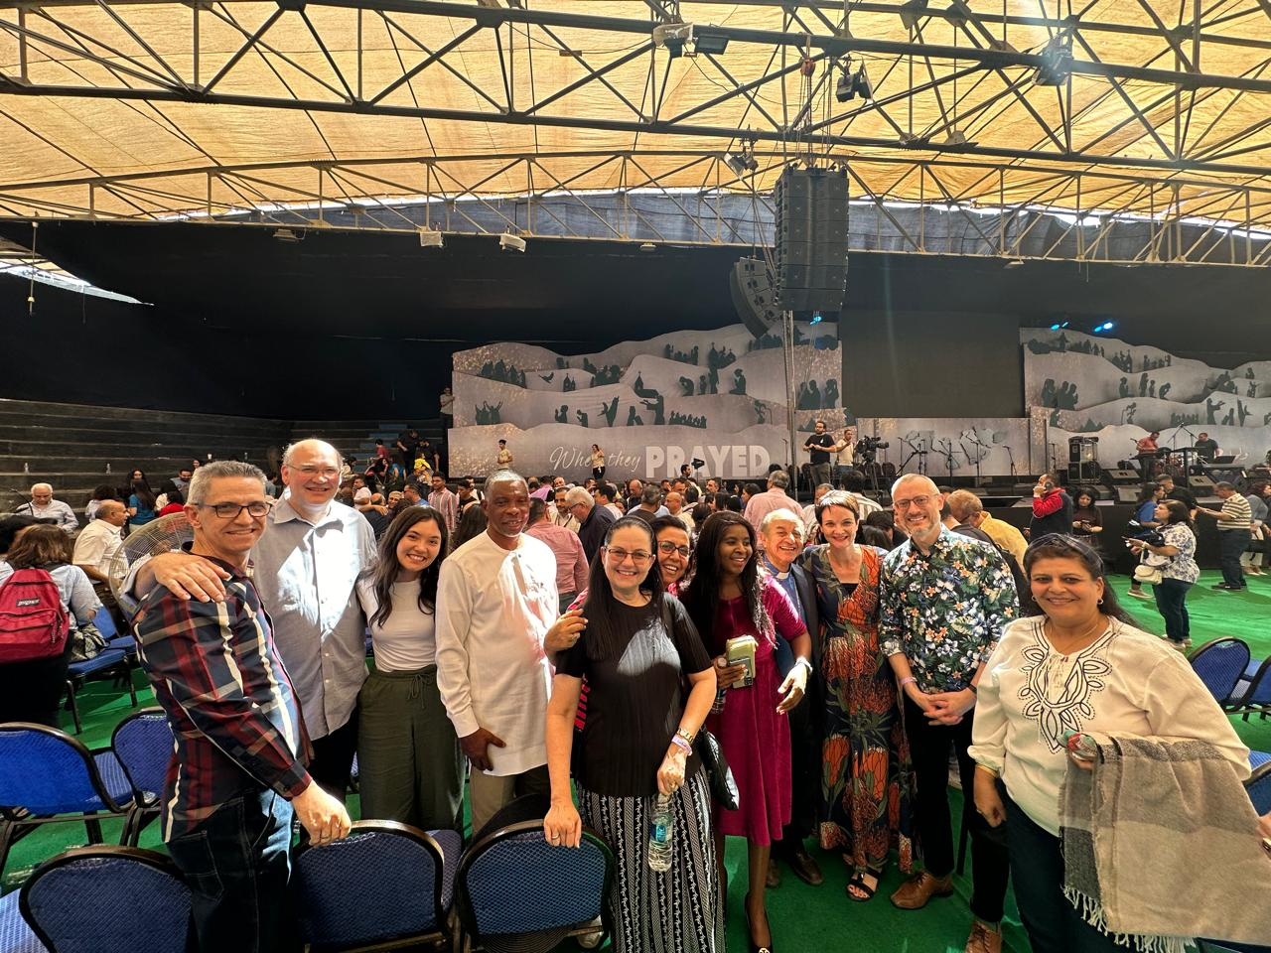
Continental Prayer Meeting Every Last Monday of the Month.
We encourage everyone to attend and participate in the monthly continental meeting every last Monday of the month.
CONTINENTAL PRAYER MEETING EVERY LAST MONDAY OF THE MONTH We encourage every one to attend and participate in the monthly continental meeting every last Monday of the month.
Enhancing your presentation

Slide 8
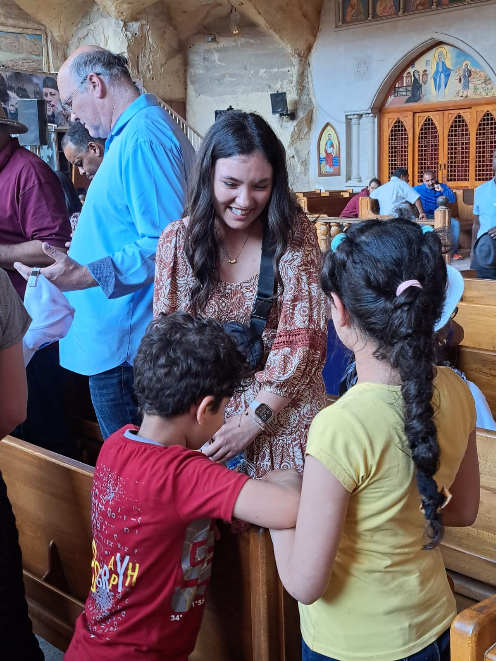
Disciple the Next Generation
Tri-Generational.
All our meetings at the regional level should be
tri –generational for wider impact on the next generation

Slide 9
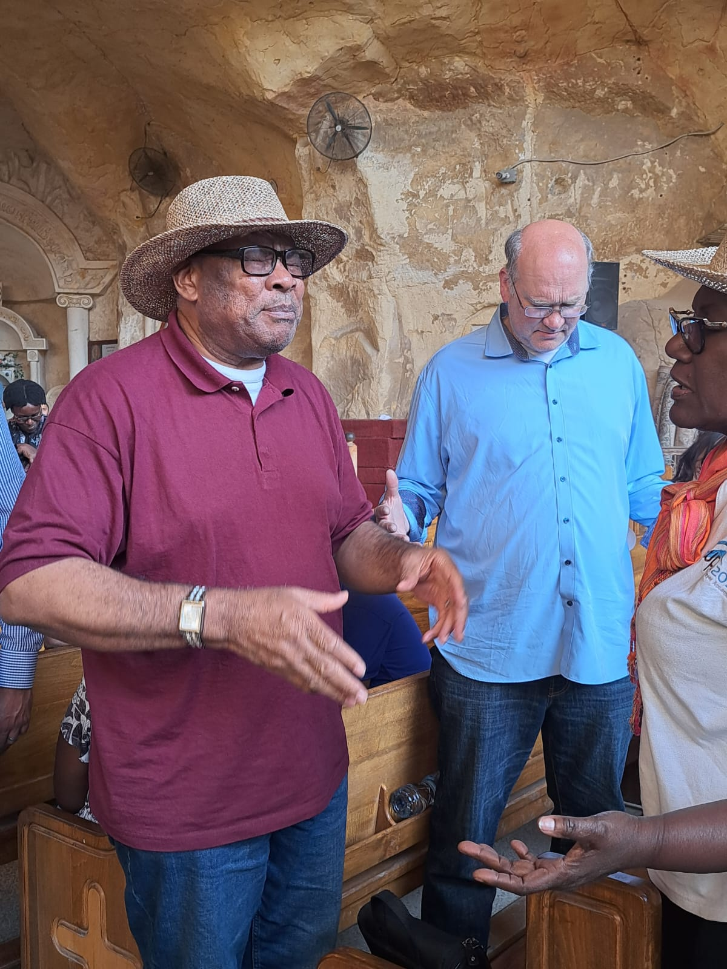
PRAYER FOR REVIVAL IN THE CONTINENT
We should continue to pray for genuine and long-lasting revival in our various regions and nations
Attention and Emphasis should be given to the IPC 7 Focus areas
Continue to pray for breakthrough in the 110 cities.

Slide 10
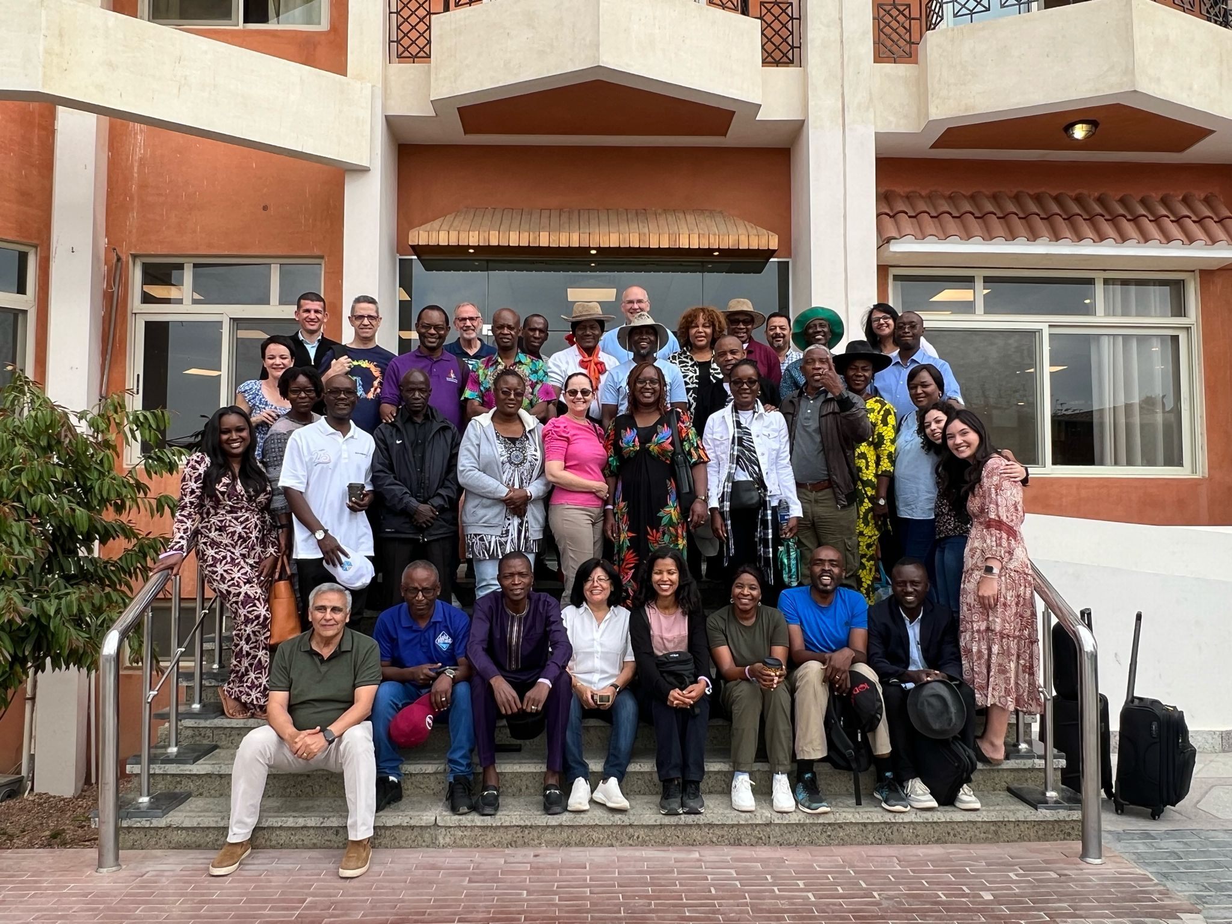
IPC TO BUILD A PRAYER APP TO ENABLE THE TRACKING OF GLOBAL PRAYER
Let us mobilize prayers for the GO Movement in May and for the Billion Souls Harvest’.
The Goal is to mobilize 10 million Intercessors to support the two Evangelism projects
Let us be living stones exemplifying the reconciliation that took place between the Egyptian brethren and the rest of Africa
(1Peter 2:5)

Slide 11
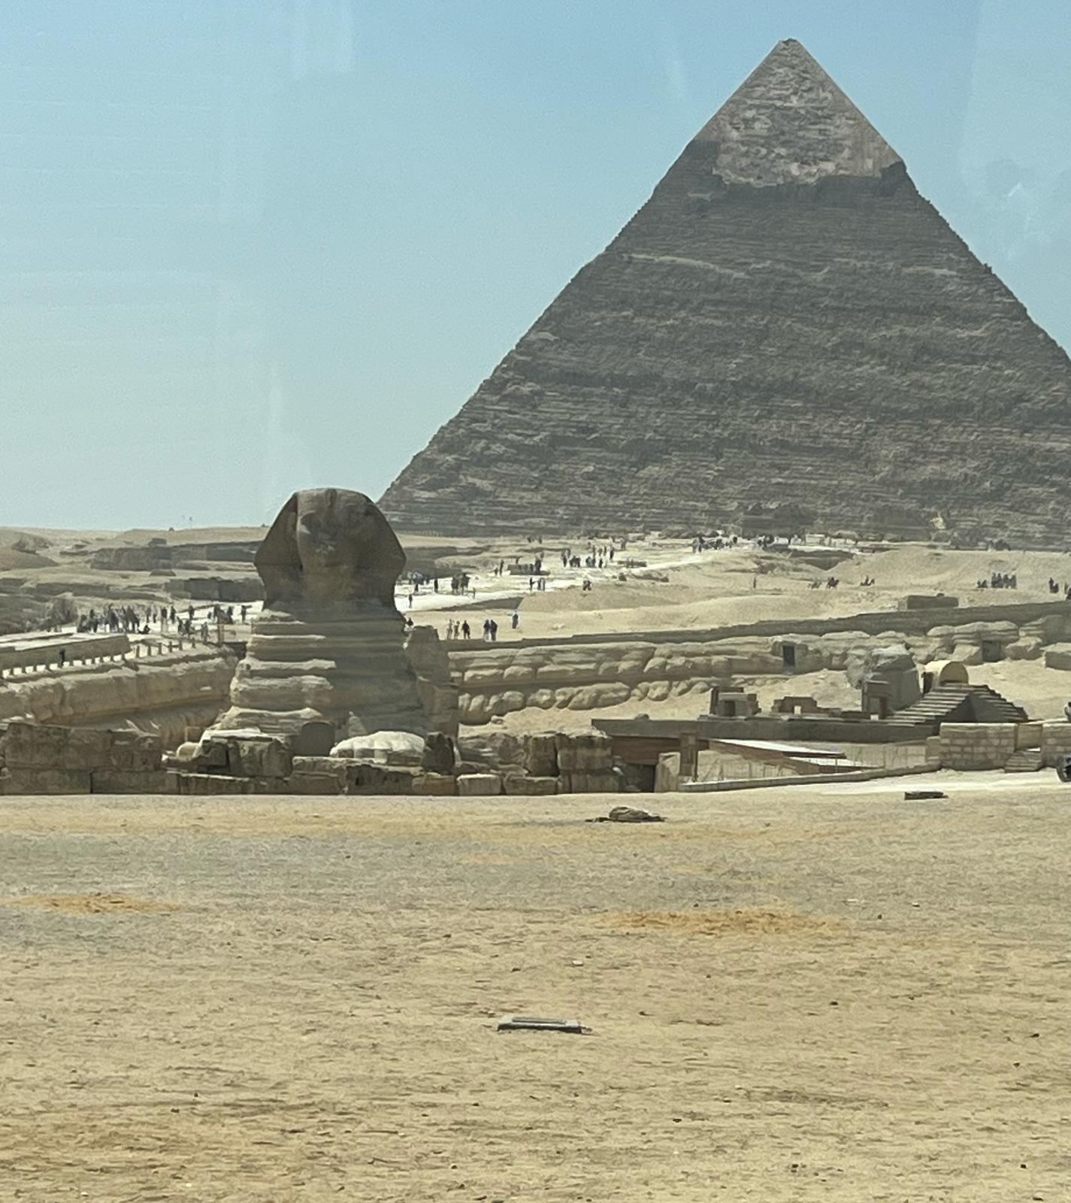
The date and location of the next conference is to be determined later and will depend on the progress made to advance in the different regions.
Next Conference???

Slide 12
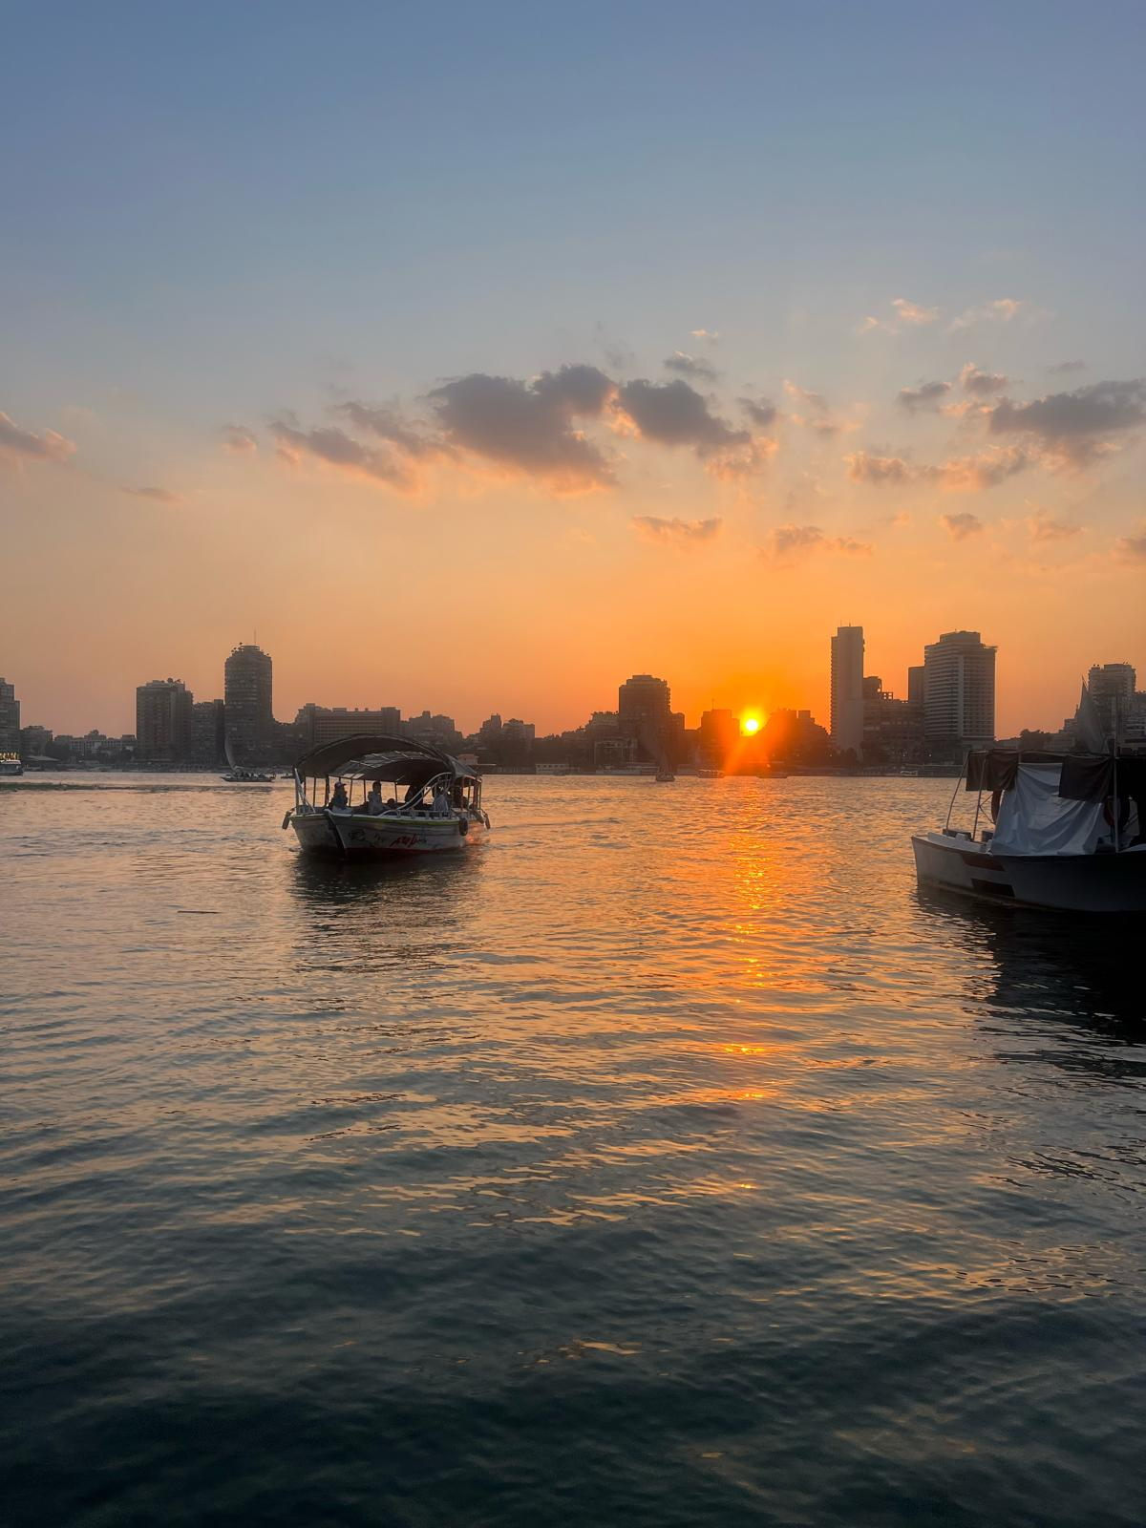
THOUGHTS!
Prayer is not about how articulate our speech is. It is about the condition of the heart. It is about your relationship with God and about holy living.
….. Always remember to ‘Pray for those no one is praying for. Pray for the unseen’

